Slide 1




Johannesburg
ConstraintLayout 2.0, What's New
Kurt Mbanje, Engineering Lead, Multichoice
@ckurtm

Slide 2
Topics Covered

Slide 3

Location
Johannesburg
ConstraintProperties
ConstraintLayoutState
Helpers
MotionLayout

Slide 4
ConstraintProperties

Slide 5

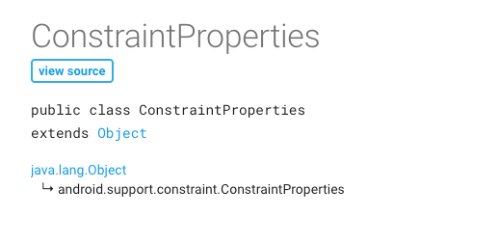

Slide 6
ConstraintLayoutStates

Slide 7
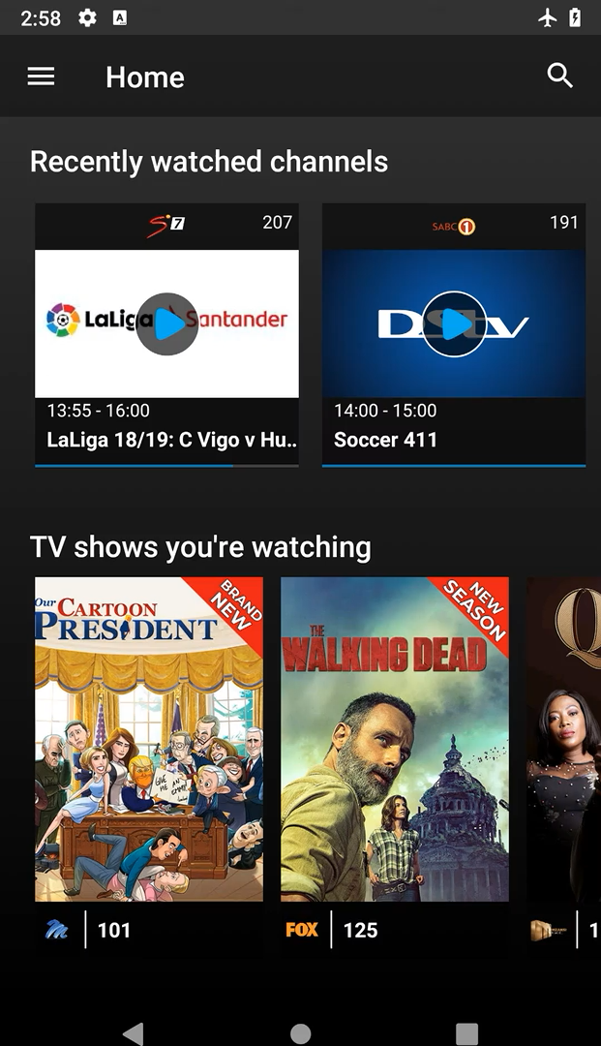
Example

Slide 8
Location
Johannesburg
Pre 2.0: ConstraintSet

Slide 9
...
val constraintLayout = findViewById<ConstraintLayout>(R.id.constraint1)
val constraintSet1 = ConstraintSet()
constraintSet1.clone(constraintLayout)
val constraintSet2 = ConstraintSet()
constraintSet2.clone(this,R.layout.state_02)
var changed = false
findViewById<Button>(R.id.button).setOnClickListener { (
if (changed) {
constraintSet1
} else {
constraintSet2
}).applyTo(constraintLayout)
changed = !changed
}

Slide 10
Location
Johannesburg
ConstraintLayoutStates

Slide 11
<ConstraintLayoutStates
xmlns:android="http://schemas.android.com/apk/res/android" xmlns:app="http://schemas.android.com/apk/res-auto">
<State android:id="@+id/one"
app:constraints="@layout/state_one”
/>
<State android:id="@+id/six" app:constraints="@layout/state_six”
app:region_widthLessThan=”500dp"
/>
</ConstraintLayoutStates>

Slide 12
…
val constraintLayout = findViewById<ConstraintLayout>(R.id.constraint1)
constraintLayout.loadLayoutDescription(R.xml.state_one)
var changed = false
findViewById<Button>(R.id.button).setOnClickListener { constraintLayout.setState(
if (changed) R.id.state_one else R.id.state_six
)
changed = !changed
}

Slide 13
Helpers

Slide 14
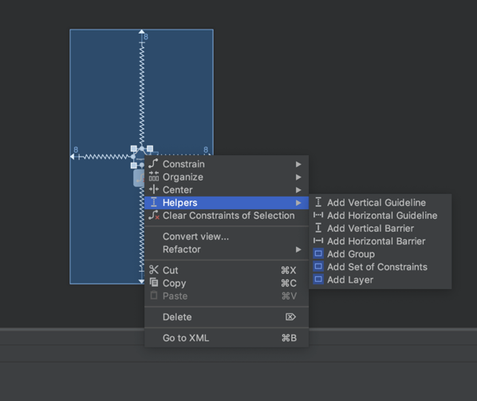

Slide 15
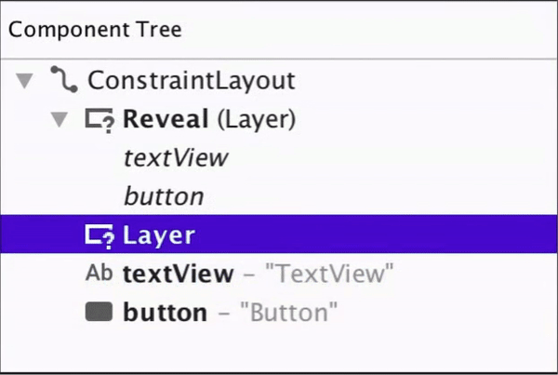

Slide 16
Location
Johannesburg
Layout Manipulation
Post Layout Manipulation
Decorators

Slide 17
MotionLayout

Slide 18
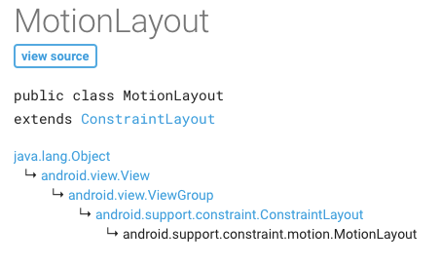

Slide 19
What is it?
Subclass on ConstraintLayout
Layout Animations (Constraint Sets)
Motion Scene Files

Slide 20
Why another animation framework?
bridges the gap between layout transitions and complex motion handling by making use of declarative motion specification.

Slide 21
implementation 'androidx.constraintlayout:constraintlayout:2.0.0-alpha2'

Slide 22
<androidx.constraintlayout.motion.widget.MotionLayout xmlns:android="http://schemas.android.com/apk/res/android" xmlns:app="http://schemas.android.com/apk/res-auto" xmlns:tools="http://schemas.android.com/tools" android:layout_width="match_parent"
android:layout_height="match_parent"
app:showPaths="true"
app:layoutDescription="@xml/trans_01"
app:applyMotionScene="true"
app:progress="0.0"
app:currentState="@id/start" >

Slide 23
Motion Scene File

Slide 24
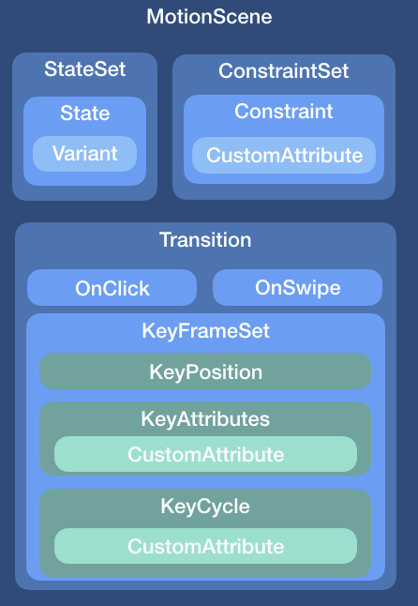

Slide 25
ConstraintSet

Slide 26
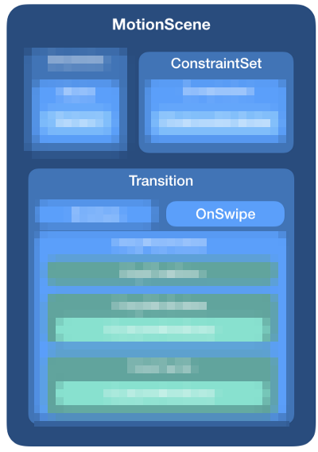
ConstraintSet
Reference

Slide 27

ConstraintSet
embed

Slide 28
alpha
Constraint
interpolators
visibility
elevation
rotation
translation
scale

Slide 29
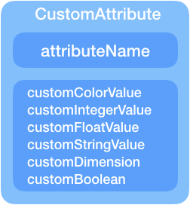
Constraint
CustomAttribute

Slide 30

KeyFrames
CustomAttribute

Slide 31
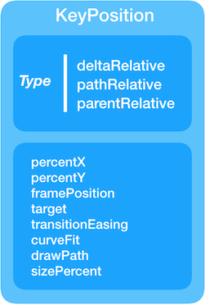
KeyFrames
CustomAttribute

Slide 32

KeyFrames
CustomAttribute

Slide 33
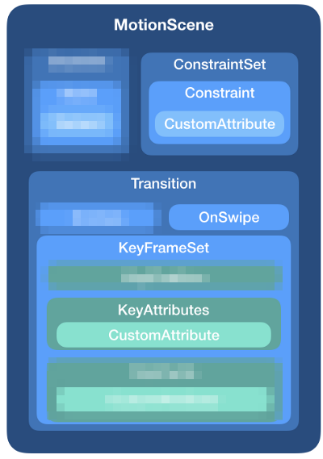
KeyFrames
key attribute

Slide 34
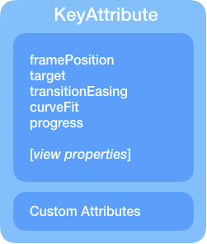
KeyFrames
key attribute

Slide 35
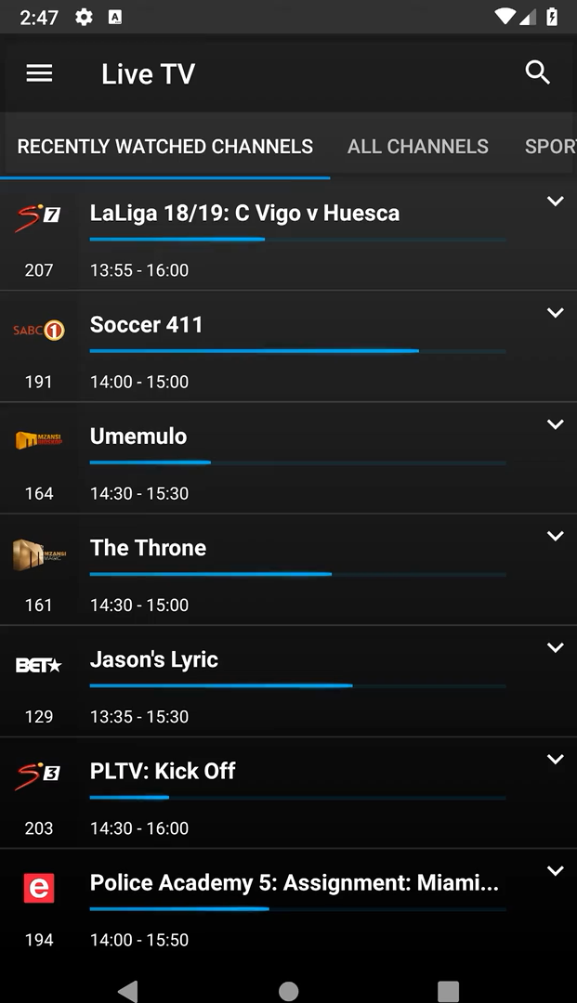
More Complex Animations

Slide 36
Demo..maybe

Slide 37
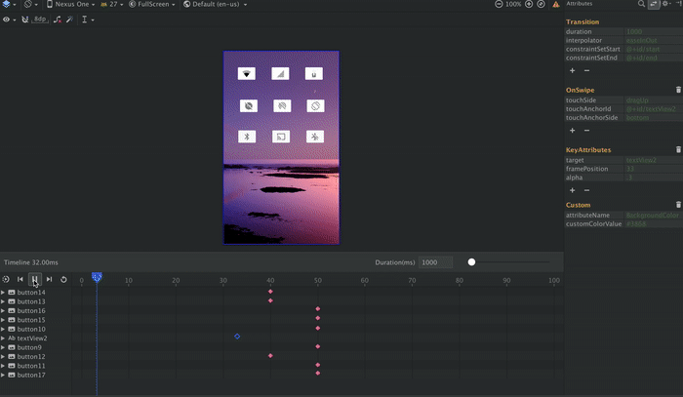
Soon!!

Slide 38
Johannesburg
Thank you!
Kurt Mbanje, Multichoice
@ckurtm

Slide 39
Johannesburg
Q&A
Ask me anything… or not

